Slide 1
INTRODUCTIONS
Williamson Vedder

Slide 2
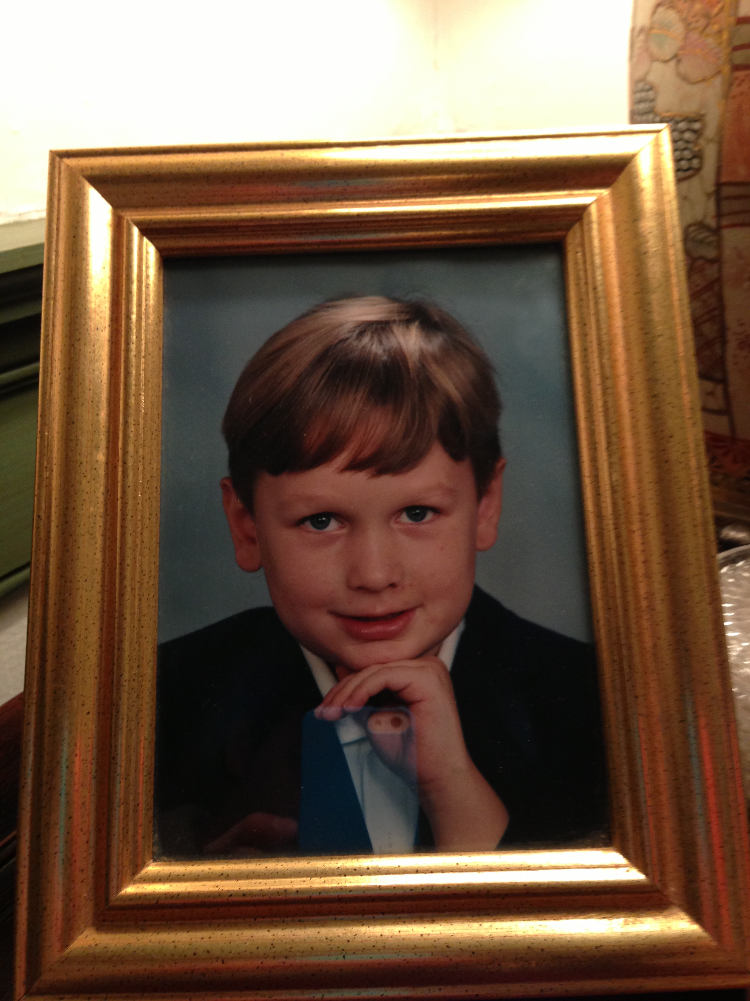

Introductions
Born in Philly, never left
Lower Merion mostly
Always nerdy hobbies growing up
Temple Grad
B.S. Engineering Technology

Slide 3
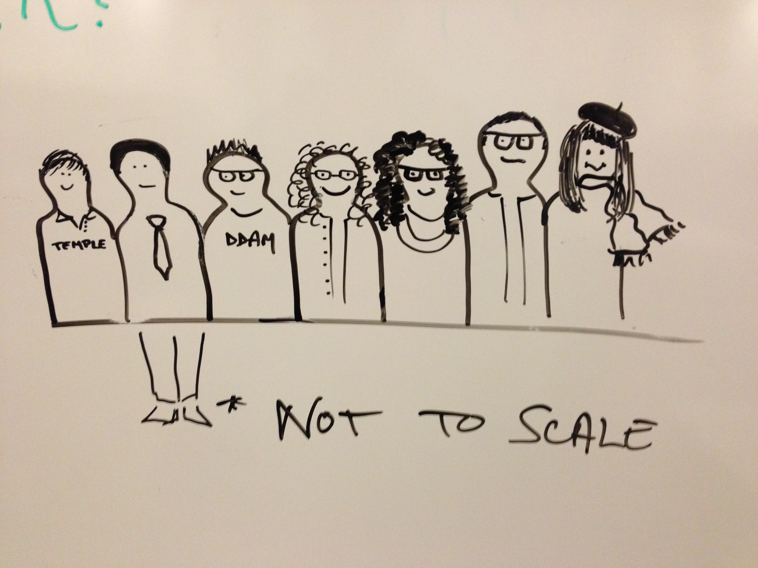
Introductions
Temple Student Worker
Provost Strategic. Comm.
Office of Sustainability
Temple In-house Web Team
Web Stuff for all

Slide 4
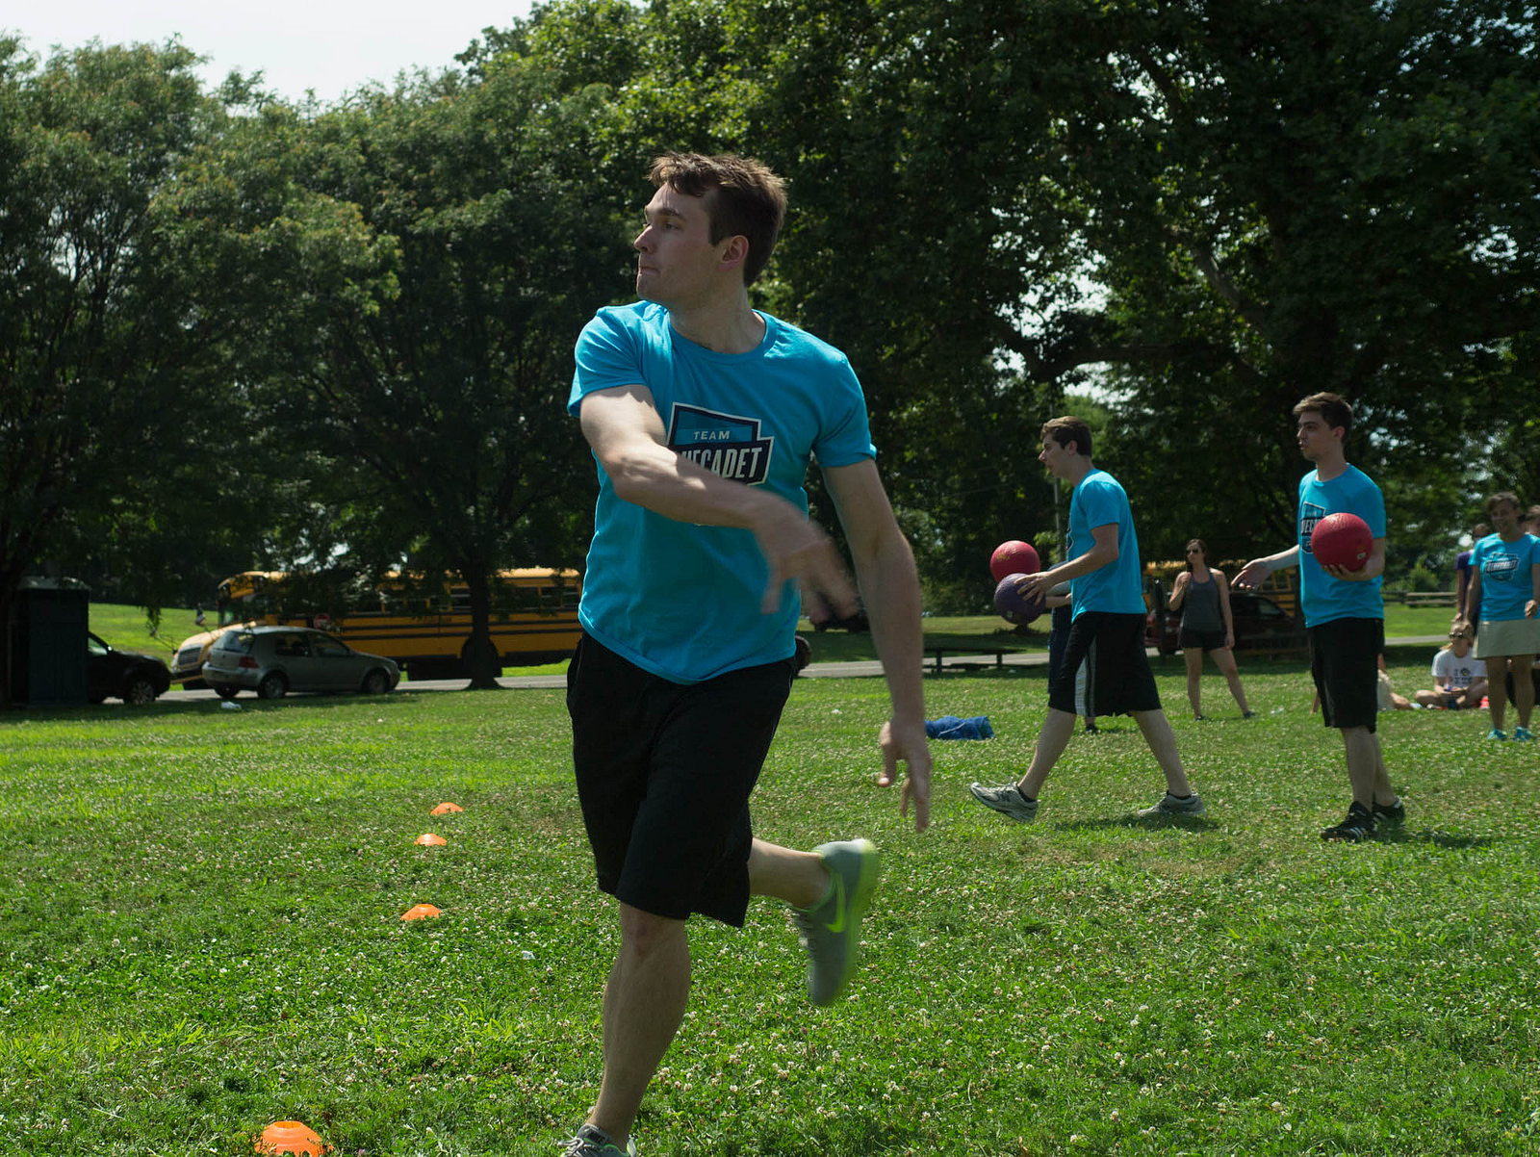
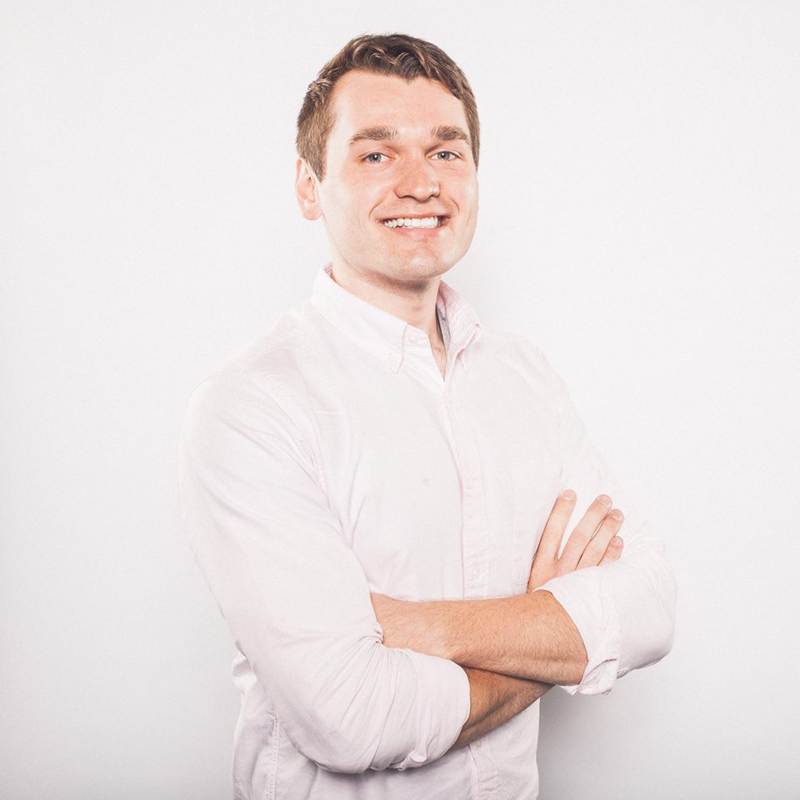
Introductions
Bluecadet in Fishtown
Musueum, non-profit niche
Creative Developer

Slide 5
Introductions
Lapham’s Quarterly - Notorious Harper-Collins editor
Oceana - World’s largest ocean conservancy
Hoover-Mason Trestle - Bethlehem’s High-line
Brandywine Museum & Conservancy – Regional museum known for Wyeth Collection

